Slide 1
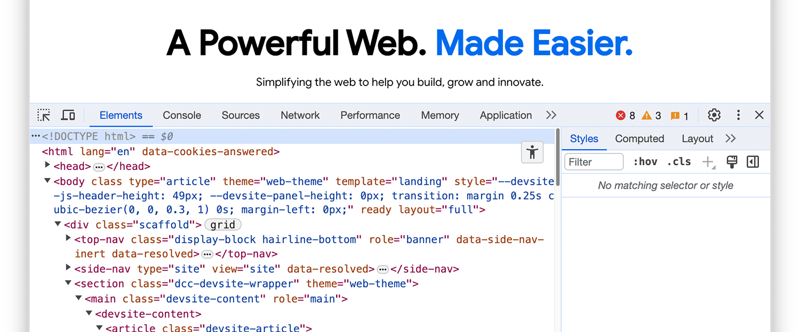
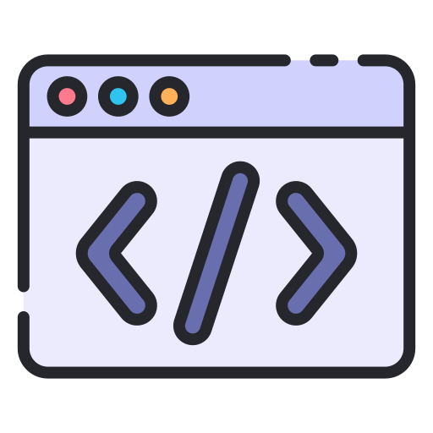
Dev tools
What is DevTools?
DevTools Developer Tools) are built-in tools in modern web browsers that help
developers inspect, debug, and optimize web pages or applications. They provide real-time insights into the structure, behavior, and performance of websites.
Why Do We Use DevTools?
Debugging Identify and fix issues in HTML, CSS, and JavaScript.
Testing Simulate different screen sizes, devices, and network conditions.
Optimization Analyze page performance and reduce load times.
Accessibility Ensure websites meet accessibility standards.
Live Editing Make real-time changes to code for rapid prototyping.
What Tools Did Developers Use Before Browser DevTools?
Before browser DevTools became mainstream, developers relied on external tools and techniques like:

Slide 2
 Firebug (for Firefox) A popular third-party extension for inspecting and debugging web pages.
 View Source Manually checking the pageʼs source code using the browser's "View Source" feature.
 Console Logging Using alert() or console.log() for debugging JavaScript.
 Text Editors/IDEs Developers would modify files locally and then reload the browser to see changes.
 Network Tools Standalone tools like Wireshark or Fiddler for analyzing network requests.
Open Dev Tools
There are many ways to open Dev Tools, because different users want quick access to different parts of the Dev Tools UI.
1.Open panels with shortcuts: Elements, Console, or your last panel
If you prefer keyboard, press a shortcut in Chrome depending on your operating system:
OS | Elements | Console | Your last panel
Windows or Linux | Ctrl  Shift + C | Ctrl  Shift + J | F12Ctrl  Shift + I
Mac | Cmd  Option + C | Cmd  Option + J | Fn  F12Cmd  Option + I
Here's an easy way to memorize the shortcuts:
C stands for CSS.
J for JavaScript.
I designates your choice.
The C shortcut opens the Elements panel in ink_selection
inspector mode. This mode shows you helpful tooltips when you hover over elements on a page. You can also click any element to view its CSS

Slide 3
in the
Elements > Styles tab.
Open Dev Tools from Chrome menus
If you prefer UI, you can access DevTools from drop-down menus in Chrome.
Open the Elements panel to inspect the DOM or CSS
To inspect, right-click an element on a page and select
Inspect.
Auto-open Dev Tools on every new tab
Run Chrome from the command line and pass the --auto-open-devtools-for-tabs flag:
 Quit any running Chrome instance.
Key point: This flag works only for the
first Chrome instance you open. If it doesn't work for you, for example, on Windows, make sure to end any residing Chrome processes from the Task Manager.
 Run your favorite terminal or command line application.
 Depending on your operating system, run the following command: macOS
open -a "Google Chrome" --args --auto-open-devtools-for-tabs
Windows:
start chrome --auto-open-devtools-for-tabs
Linux:
google-chrome --auto-open-devtools-for-tabs
Dev Tools will automatically open for every new tab until you close Chrome.
Customize Dev Tools

Slide 4
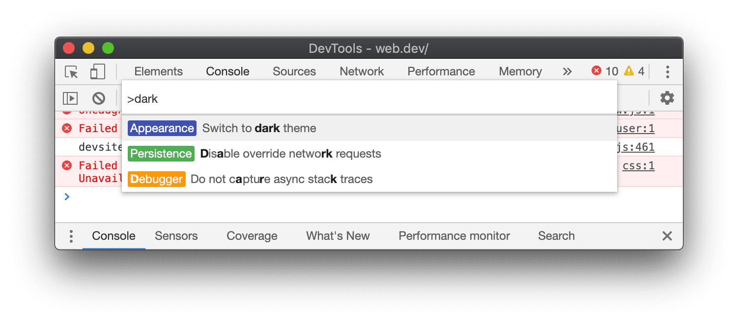
Settings
settings Settings > Preferences contains many options for customizing DevTools. See Open Settings and Preferences.
Dark theme
You can enable dark theme in Settings
or the Command Menu.
 Open the Command Menu.
 Start typing dark , select the Switch to dark theme command, and then press Enter to run the command.
 Alternatively, set your theme in settings Settings > Preferences > Appearance > Themes.
Dynamic theme
DevTools can automatically match Chrome's color theme.

Slide 5
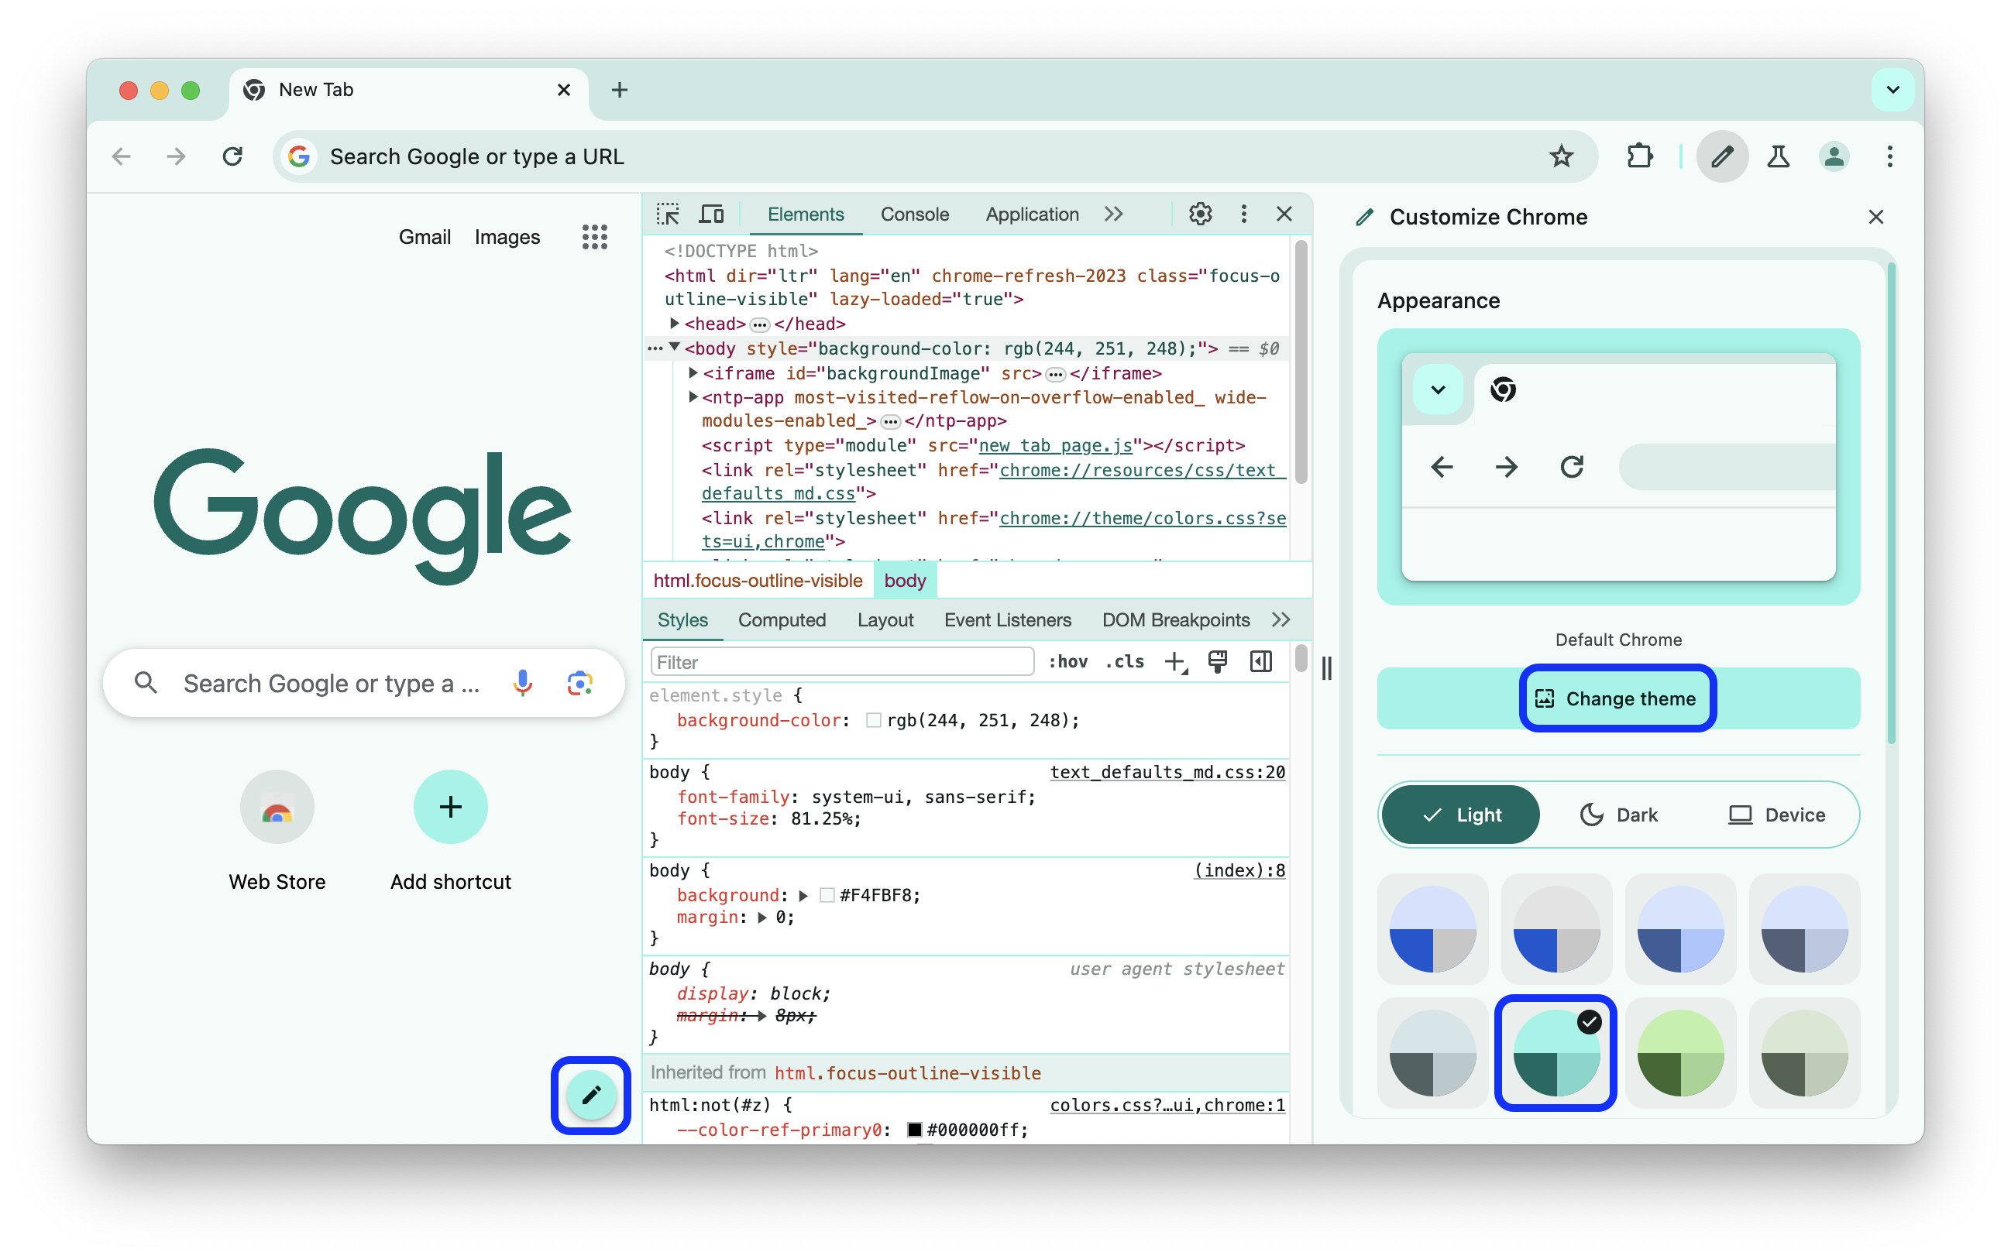
To set a theme:
 Open a new tab and click edit Customize Chrome in the right bottom corner.
 In Appearance, pick a theme through wallpaper Change themes or select a color palette.
To turn off dynamic theming, clear settings Settings > Preferences > Appearance
> check_box_outline_blank Match Chrome color scheme and reload DevTools.
Drawer
The Drawer contains many hidden features. Press Escape to open or close the Drawer.

Slide 6
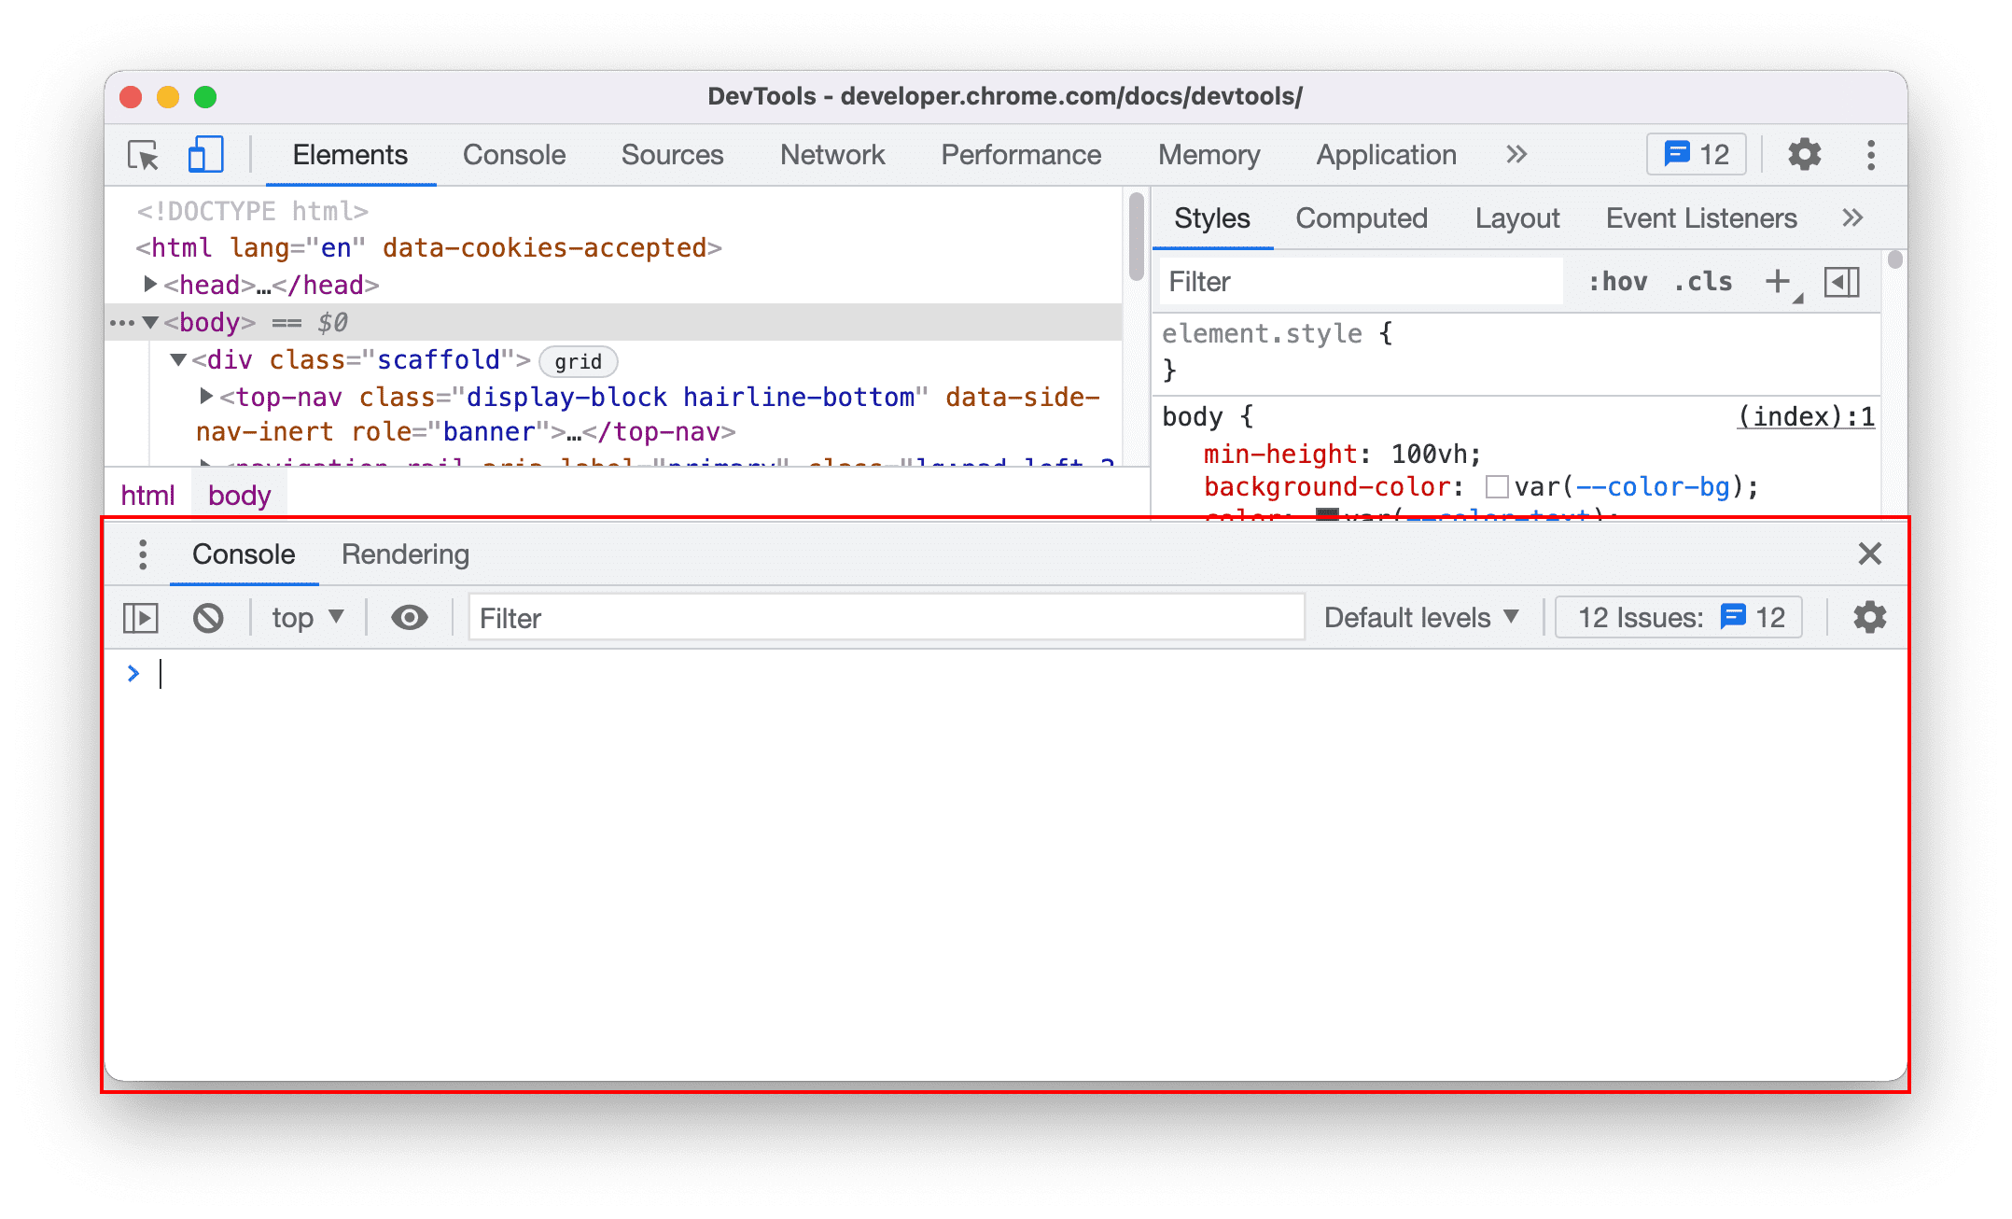
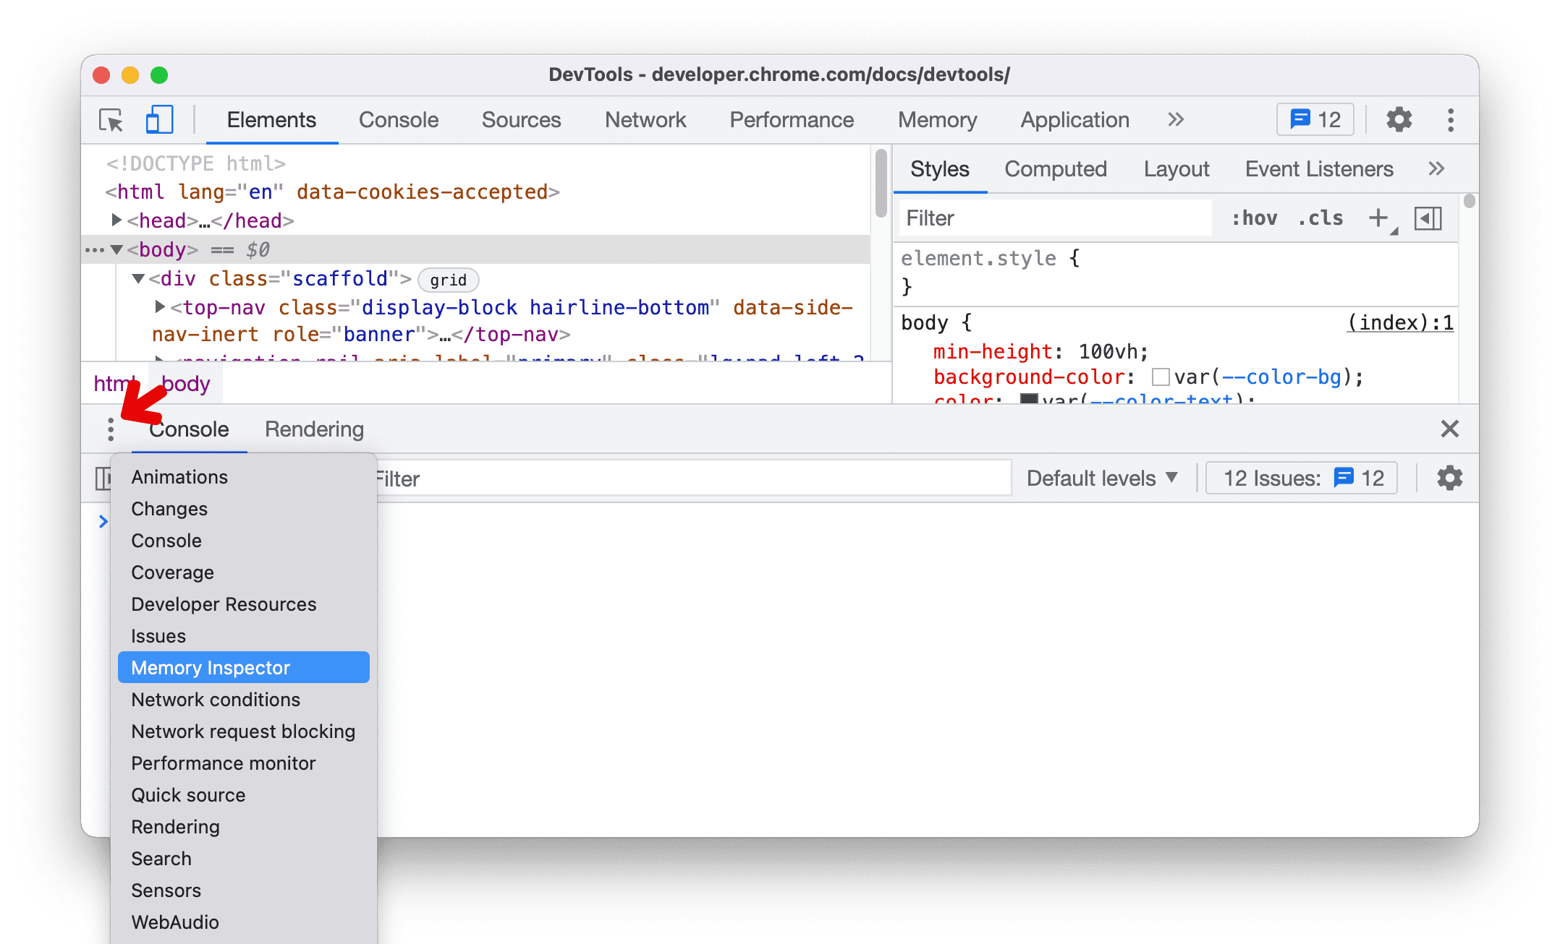
Click ⋮ More Tools to open other Drawer
tabs.

Slide 7
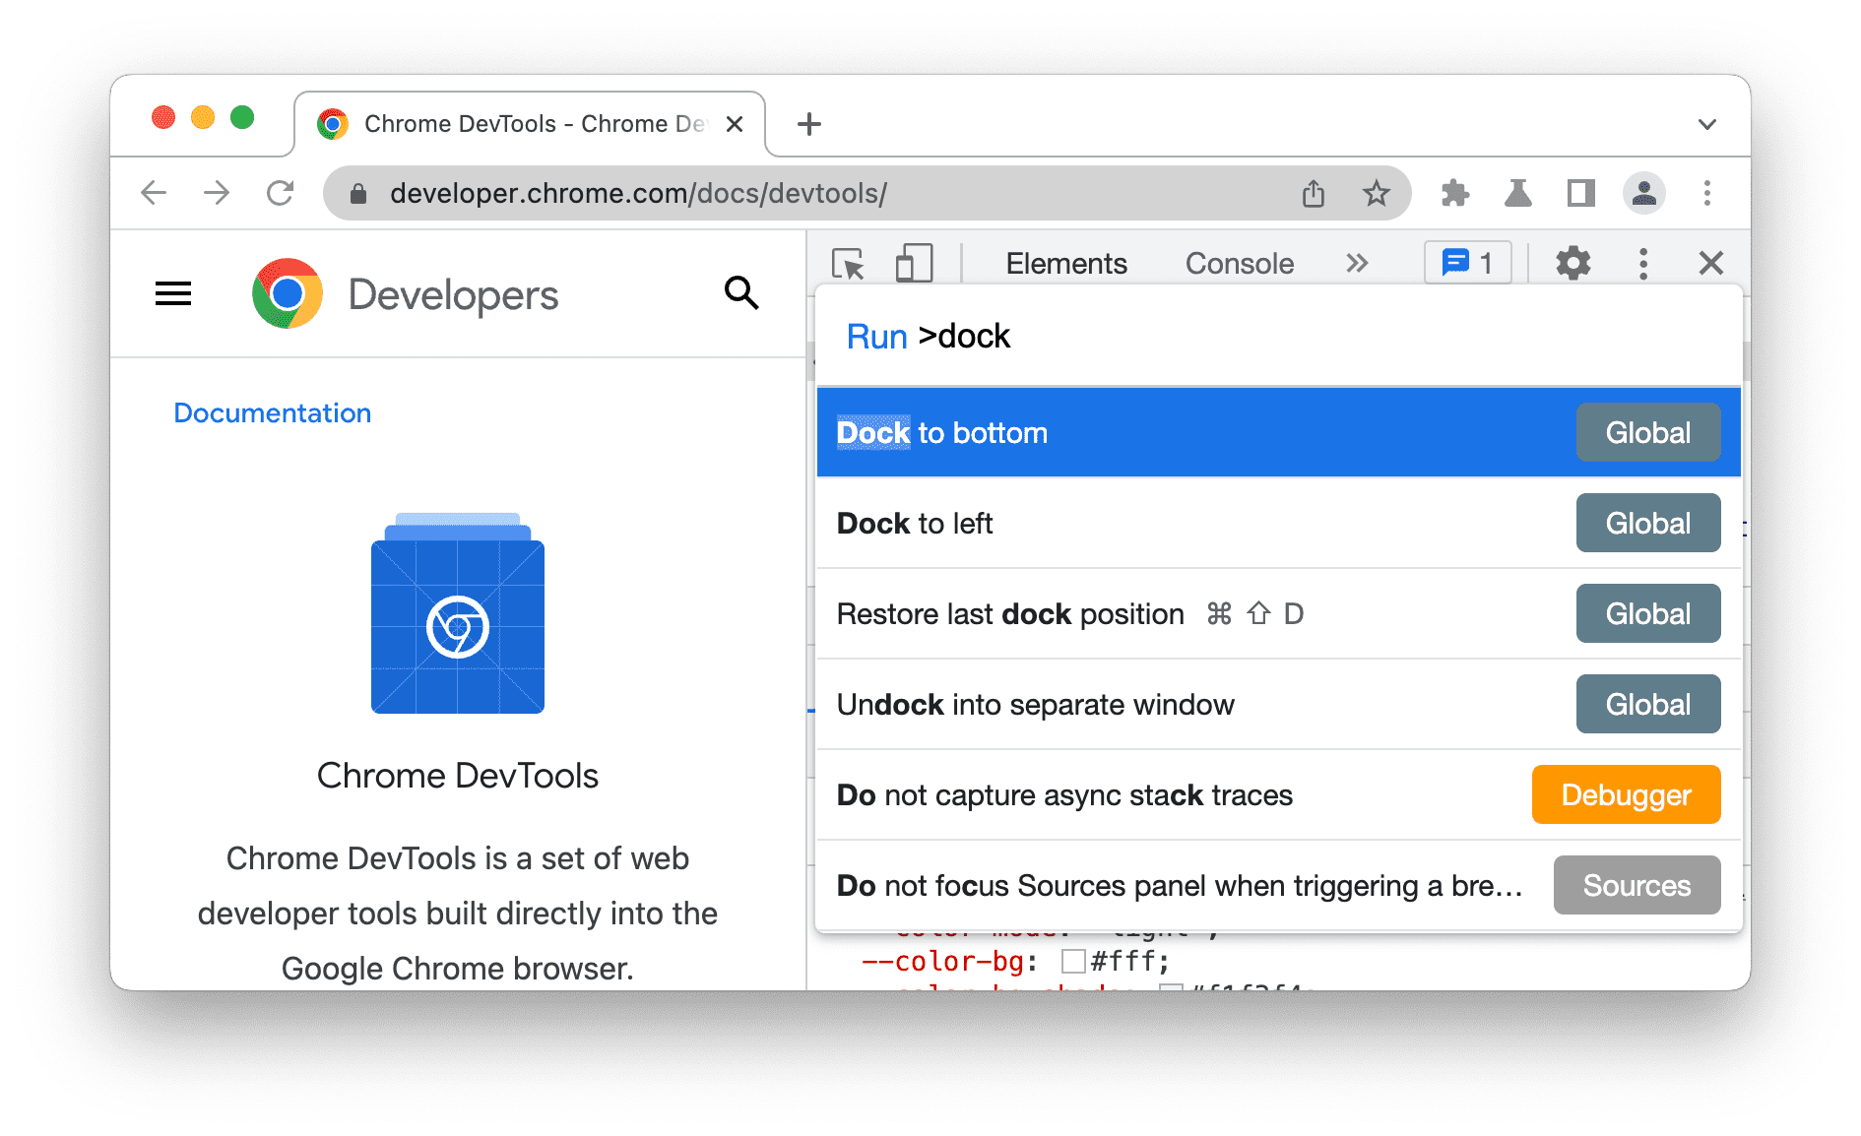
Change Dev Tools placement
By
default, Dev Tools is docked to the right of your viewport. You can also dock to the bottom or left sides or undock Dev Tools into a separate
window.
You can change the placement of Dev Tools in two ways:
Main Menu Open more_vert Customize And Control DevTools and click: ad_group Undock into separate window
dock_to_right Dock to left
dock_to_bottom Dock to bottom
dock_to_left Dock to right Command Menu:
 Open the Command Menu.
 Start typing dock and select one of the suggested options: dock to bottom, left, right, undock, or restore last dock position.

Slide 8
To toggle Restore last dock position with a keyboard shortcut, press:
On Linux or Windows: Ctrl+Shift+D
On macOS Cmd+Shift+D
Reorder panels, tabs, and panes
To change ordering, click and drag left or right any of the following: Panels at the top of DevTools.
Panes in the Elements panel such as Styles, Computed, Layout, and others.
Panes in the Sources panel such as Page, Workspace, Overrides, and others.
Drawer tabs at the bottom of DevTools.
Additionally, you can move panels and tabs up and down to and from the Drawer. To do this, right-click the panel or tab and select Move to top or Move to bottom from the drop-down menu.
Your custom tab order persists across DevTools sessions.
Panel layout
By
default, DevTools will auto-rearrange your panel layout depending on window size. You can disable the auto-rearrangement. Go to settings
Settings > Preferences > Appearance and update the panel layout based on your preference.
For example, the Styles pane in the Elements panel will move from the side to the bottom when screen size is small. If you want the Style pane to always stay on the side, change the panel layout to vertical.

Slide 9
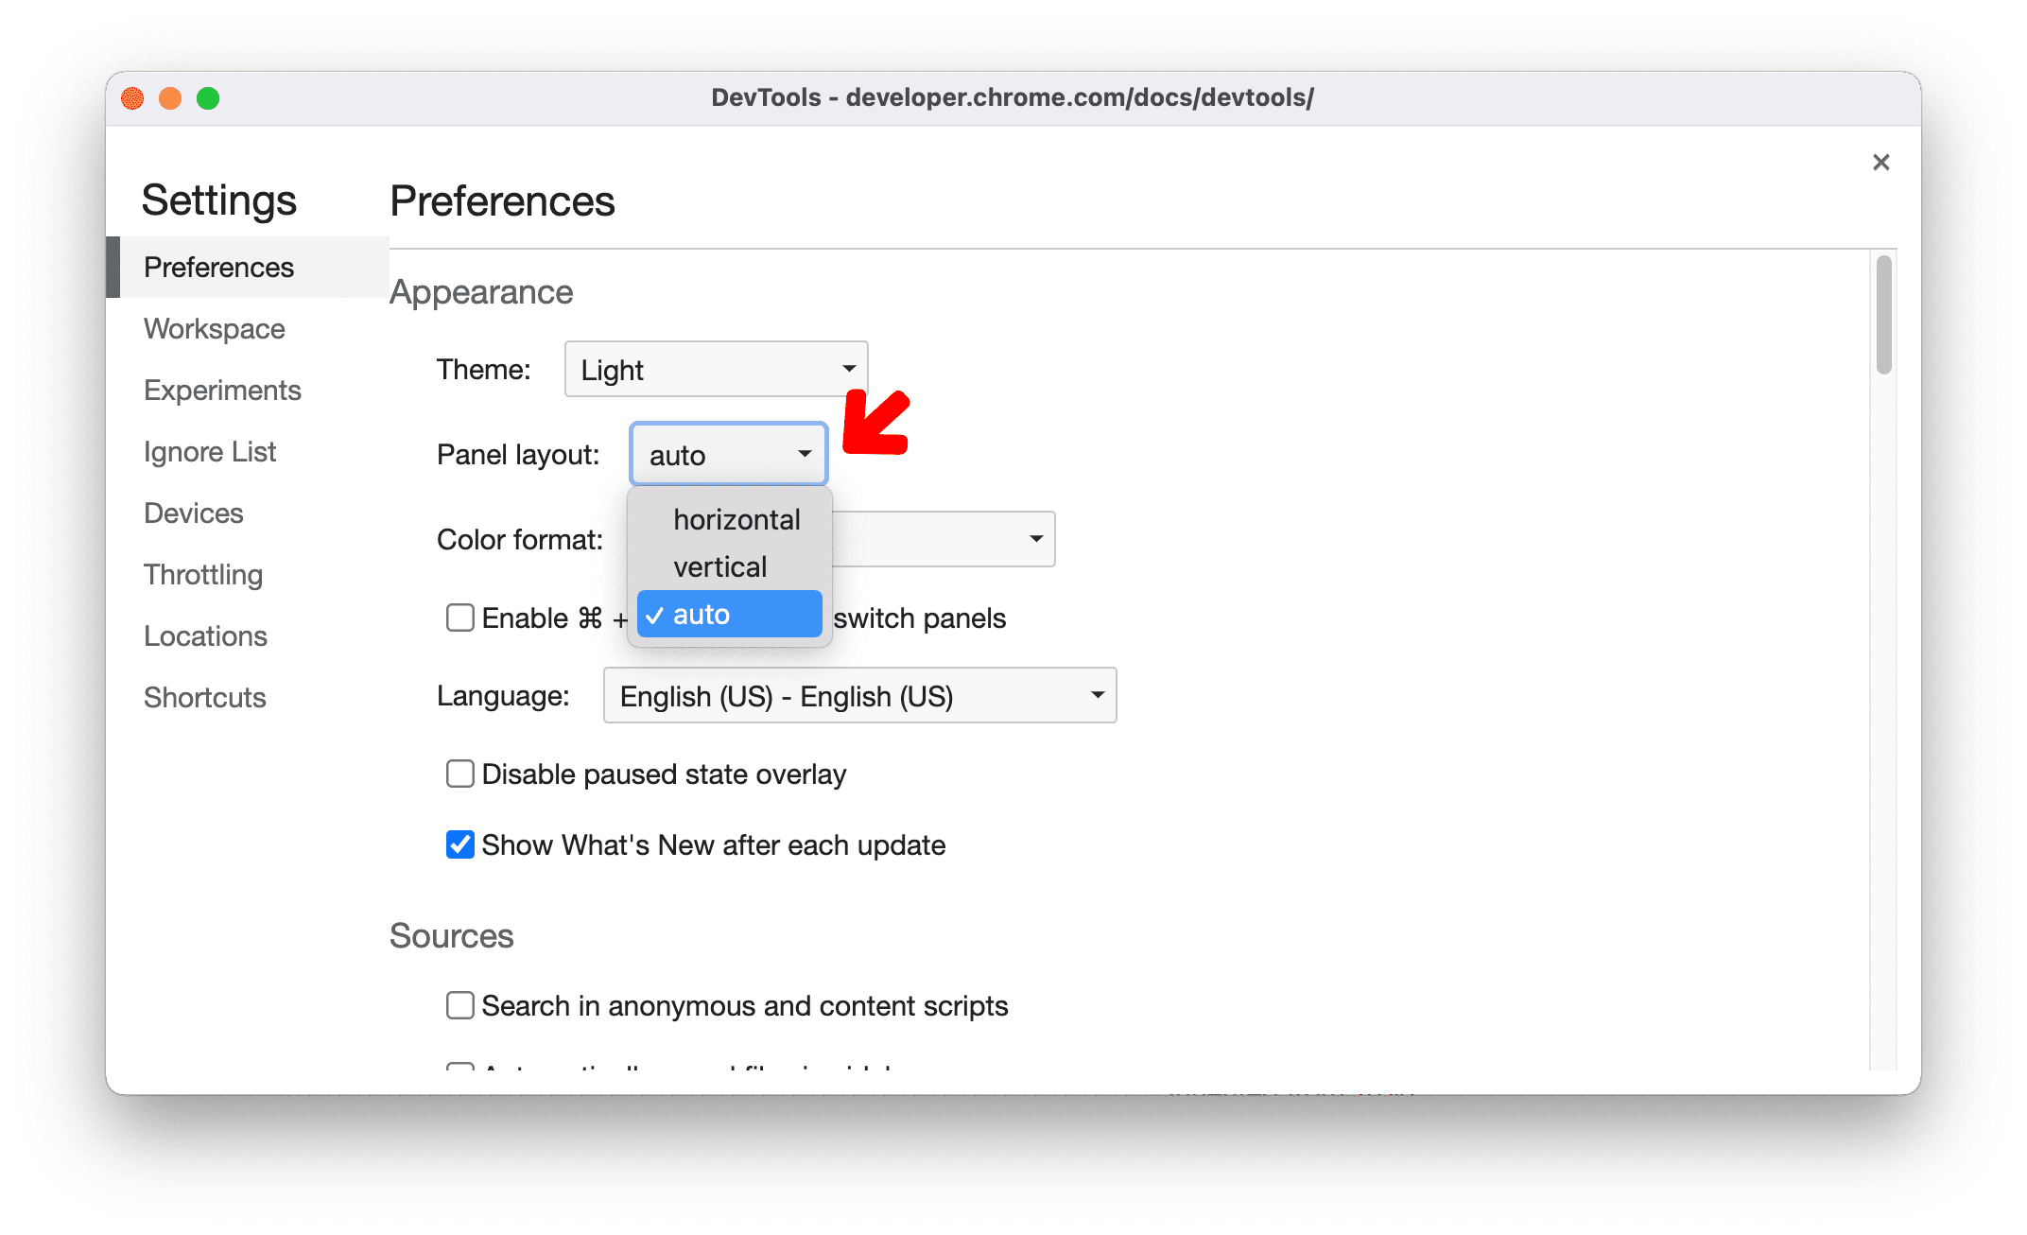
Change DevTools UI language
See settings Settings > Preferences > Appearance > Language.

Slide 10
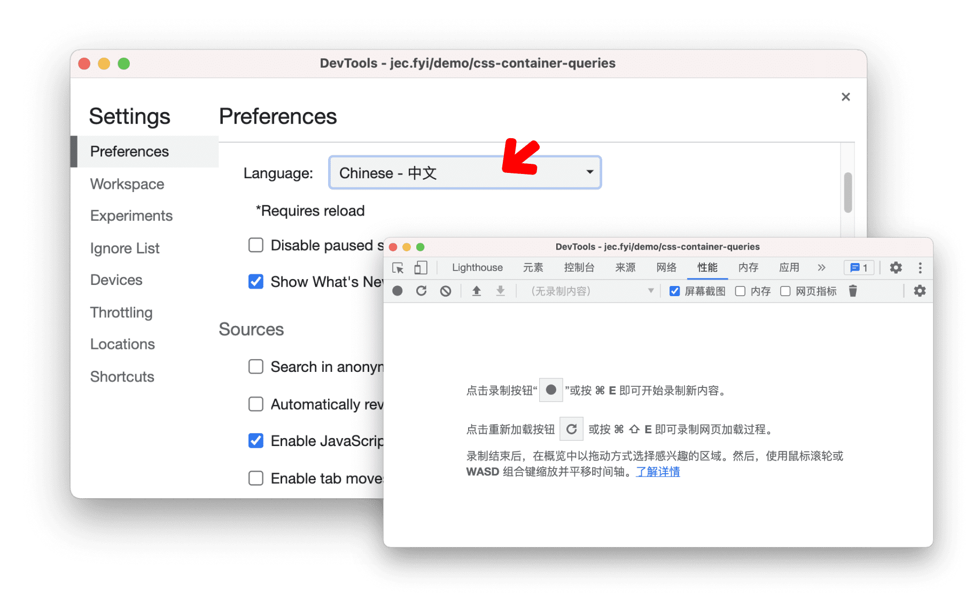
Panels in Dev Tools
 Elements Panel:
Purpose View and edit HTML and CSS of a page.
Use Change styles, inspect elements, and modify the page's structure.
 Console Panel:
Purpose View log messages, errors, and run JavaScript.
Use Debug code, check logs, and test JavaScript code interactively.
 Network Panel:
Purpose Monitor all network requests (e.g., images, scripts).
Use Check how resources are loading and troubleshoot slow performance.
 Sources Panel:
Purpose Inspect and debug JavaScript code.

Slide 11
Use Set breakpoints and step through code to find bugs.
 Performance Panel:
Purpose Analyze website performance.
Use Track CPU, memory usage, and rendering performance.
 Application Panel:
Purpose Manage storage, service workers, and web app features.
Use View cookies, local storage, and cache data.
 Security Panel:
Purpose Check the security of the page (e.g., HTTPS status).
Use Ensure the page is secure and has a valid SSL certificate.
 Lighthouse Panel:
Purpose Run audits for performance, accessibility, and SEO.
Use Get suggestions to improve the website's quality.
 Memory Panel:
Purpose Track memory usage and identify leaks.
Use Optimize memory and prevent issues like memory leaks.
 Accessibility Panel:
Purpose Check accessibility features (e.g., for screen readers).
Use Ensure the page is usable for people with disabilities.
Elements Panel
1. Inspecting the Webpage Structure
HTML Viewer:
On the left side, see the webpageʼs structure HTML.
Hover over elements in the HTML tree to highlight them on the page.

Slide 12
CSS Viewer:
On the right side, see the styles CSS applied to the selected element.
Editing HTML
Modify Text:
Right-click an element  Select "Edit as HTML"  Change the text.
Add or Remove Elements:
Right-click  Add or delete elements to change the structure.
Editing CSS
Change Styles:
Modify styles like color , font-size , or background in the Styles section on the right.
Toggle Styles:
Use checkboxes to turn CSS rules on/off and see the effect instantly.
Add New Rules:
Add new properties by clicking on empty lines in the Styles section.
Box Model (Layout)
What It Shows:
The Box Model displays how margins, borders, padding, and content are spaced for the selected element.
How to Change:
Adjust values directly in the Box Model to see real-time changes.
Real-Time Debugging
Experiment with Design:

Slide 13
Show how changing styles (like font size or color) updates the webpage instantly.
Fix Issues:
Example: If text is hard to read, increase the font size or change the color live.
6. Hands-On Practice
Inspect a sample webpage. Try:
Changing the text of a heading. Modifying the background color.
Adjusting the padding and margin of an element.
Quick Tips & Tricks
Editing CSS
Adding CSS Rules Editing HTML
Scroll into View Console Shortcuts
Hide and Show Elements Simulate States
Computed Styles HTML Breakpoints
Find Event Listeners
Changing Color Formats Import Custom Theme

Slide 14

CSS Specificity
Accessible Color Picker Accessibility Panel
Exercise 1 - Quick Edits
 Change this list from an ordered list ol to an unordered list ul .
 Can you find the JavaScript code that calls the alert ?
There is a button below. When clicked, it will reveal a blockquote . The blockquote
has the following HTML
<blockquote class="quote" id="quote" style="background-color: blue;">
Did you get it right?
</blockquote>
And the following CSS
blockquote {
background-color: red;
}
.quote {
background-color: orange;
}
#quote {
background-color: yellow !important;
}
 Can you guess what background color it will have?
 Can you "cheat" using the Dev Tools to be 100% sure before you click?

Slide 15
There are a bunch of cards! Can you figure out the border color of the one with id 12345678? Can you do it in a way that would work if there were 1000 cards on the page?
Apple
Bird
Car
Dove
Elephant
Fire
Goat
Hello
Igloo
Jon

Slide 16
Kuperman 😂
Lion
Mars
Nope
Console Panel
Basic Console Commands:
Log a Message:
The most basic thing you can do in the Console is log messages using
console.log() .
Type the following in the Console and press Enter:
console.log('Hello, Console!');
This will print the message "Hello, Console!" to the Console. This is helpful for debugging and tracking code execution.
Logging Different Data Types:
You can log different data types, such as strings, numbers, objects, and arrays.
Try the following in the Console:

Slide 17
console.log(123); // Logs a number console.log({ name: 'Michal', age: 20 }); ct
// Logs an obje
console.log([1, 2, 3, 4]); // Logs an array
c. Logging with Multiple Arguments:
You can also log multiple values at once. Type the following in the Console:
console.log('The result is:', 42); console.log('User:', { name: 'Michal' }, 'Age:', 20);
This will print a string followed by the number and object/variables in a more readable format.
Using console.error() , console.warn() , and console.info() :
console.error()  Logs errors with a red color.
Try typing:
console.error('This is an error message.');
console.warn()  Logs warnings with a yellow color.
Try typing:
console.warn('This is a warning message.');
console.info()  Logs information with a blue color.
Try typing:
console.info('This is an informational message.');

Slide 18
Using to Log Data in a Table:
console.table()
The console.table() function is useful for logging arrays or objects in a table format. Try this:
javascript Copy code
let users [
=
{ name: 'Alice', age: 25 },
{ name: 'Bob', age: 30 },
{ name: 'Charlie', age: 35 }
];
console.table(users);
This will display the users array in a table format, making it easier to view the properties of each object.
Clear the Console:
Sometimes, you might want to clear the Console to get rid of all the logs. You can do this by typing:
console.clear();
This clears the console window.
Exercise - 2
DOM Interaction
In this HTML structure, we have:
 A heading <h1> with the ID header .

Slide 19
 A button with the class button .
 A container <div> with the class container that will hold some dynamic content. Now, let's write JavaScript code that interacts with this page via the Console.
Interacting with the DOM
 Selecting Elements:
let heading = document.getElementById('header'); selects the header element using its ID.
let clickButton = document.querySelector('.button'); selects the first element with the class button .
 Manipulating Text Content:
header.textContent = 'New Header Text'; changes the text content of the header
element to the new value.
 Changing Styles:
We modify the buttonʼs background color and font size using inline styles:
button.style.backgroundColor 'lightgreen';
=
button.style.fontSize = '18px';
 Adding New Elements:
We create a new paragraph using document.createElement('p') , add text to it with textContent , and then append it to an existing container:
let container document.querySelector('.container');
=
let newParagraph = document.createElement('p'); newParagraph.textContent = 'New paragraph added after b utton click!';
container.appendChild(newParagraph);
 Using setTimeout to Add Elements Dynamically:

Slide 20
Source Panel
We use setTimeout to simulate delayed execution, adding a paragraph after 3 seconds.
Source Panel
The Source Panel is where you can view and debug the code running on a webpage.
View Files It shows all the files (like JavaScript, CSS, etc.) used by the webpage.
Set Breakpoints You can click on line numbers in the code to pause the script and inspect whatʼs happening.
Step Through Code Once paused at a breakpoint, you can move through the code line-by-line to see how it works.
Watch Variables You can track the values of specific variables as you step through the code.
Workspace
The Workspace feature lets you edit your local project files directly in the browser.
Link Local Files You can link your project files (on your computer) to the browser's DevTools.
Edit Files in DevTools After linking, you can edit JavaScript, CSS, or HTML directly in the browser.
Save Changes Changes you make in DevTools can be saved to your actual files on your computer.
How It Works Together:
Source Panel helps you debug your code (pause, inspect, step through).

Slide 21
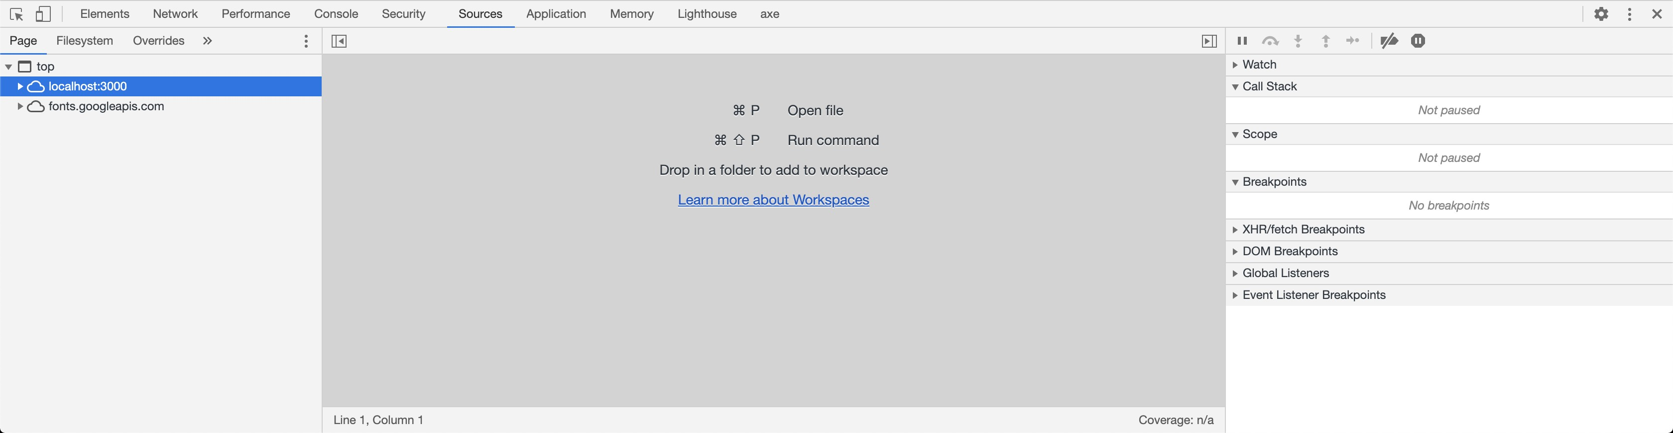
Workspace allows you to edit and save your code live in the browser, speeding up development.
Example Workflow:
 Debug in the Source Panel Set breakpoints in your code, step through it, and watch variables change.
 Edit in the Workspace Modify your code directly in the browser, then save the changes to your local files.
Exercise - 3
Instructions
 Open the DevTools
 Click on the Sources panel
 Open Windows Explorer / Finder and navigate to this project
 Grab the workspace folder and drag it into the workspace section.
 Click allow at the top of your browser window.

Slide 22
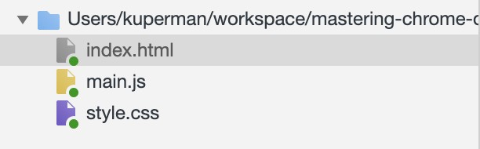
 You should now see little green circles next to all of the filenames in the sidebar.
 Then complete the three tasks outlined in the Workspace!
Nothing happens
First, we need to check the console for any logged output. Then, we'll examine the JavaScript in the source panel.
Inside the form.addEventListener() function:
 Remove the line console.log(form.value);
 Add the line items.push(form.value);
Debugging
For demonstration purposes, we're just logging in the background with an interval. Click on the Debugging.js file.
If you click on a function, it will turn blue, indicating that a Breakpoints is set. Once the Breakpoints is created, you won't see any more console logs here.
Set and activate breakpoints
Use the debugger keyword Walk the call stack
Set conditional breakpoints Set XHR breakpoints

Slide 23
Exercise - 4
Debugging
The area below is supposed to be a list of interesting facts about cats! If you look at the HTML you'll see the following:
<ul id="catfacts"></ul>
And a file in this repository /exercises/js/Debugging.js is hitting an API and supposed to populate that list! Can you figure out what's going wrong?
Hint: Checking the console is a great place to start. Once you've identified the area, use the debugger in the Sources tab to get a lay of the land.
Here is a list of FACTS about CATS
May be…
 Open the Debugger.js file
 Inspect the DevTools interface
 Go to the console and fix the error:
const li = document.createElement("li");
 Navigate to Sources and resolve the undefined value
 Set breakpoints at:
li.innerText = inner.fact
 Open the Watch panel and enter "li"

Slide 24
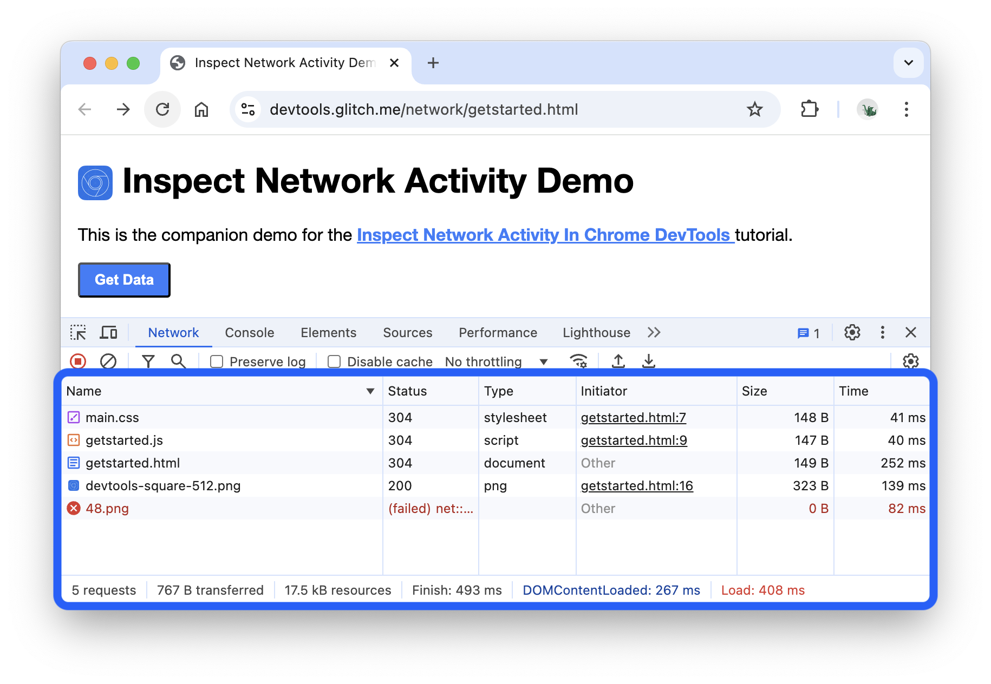
Network Performance
Open the Network panel
 Add "item" to the watch list
To get the most out of this tutorial, open up the demo and try out the features on the demo page.
 Open the Get Started Demo.
Log network activity
To view the network activity that a page causes:
 Reload the page. The Network panel logs all network activity in the Network Log.

Slide 25
Each row of the Network Log represents a resource. By default the resources are listed
chronologically. The top resource is usually the main HTML document. The bottom resource is
whatever was requested last.
Each column represents information about a resource. The default columns are:
Status The HTTP response code.
Type The resource type.
Initiator What caused a resource to be requested. Clicking a link in the Initiator column
takes you to the source code that caused the request.
Size Resource amount transferred over the network.
Time How long the request took.
 So long as you've got DevTools open, it will record network activity in the
Network Log. To
demonstrate this, first look at the bottom of the
Network Log and take note of the last activity.
 Now, click the Get Data button in the demo.
 Look at the bottom of the Network Log again. There's a new resource called
getstarted.json . Clicking the Get Data button caused the page to request this file.

Slide 26
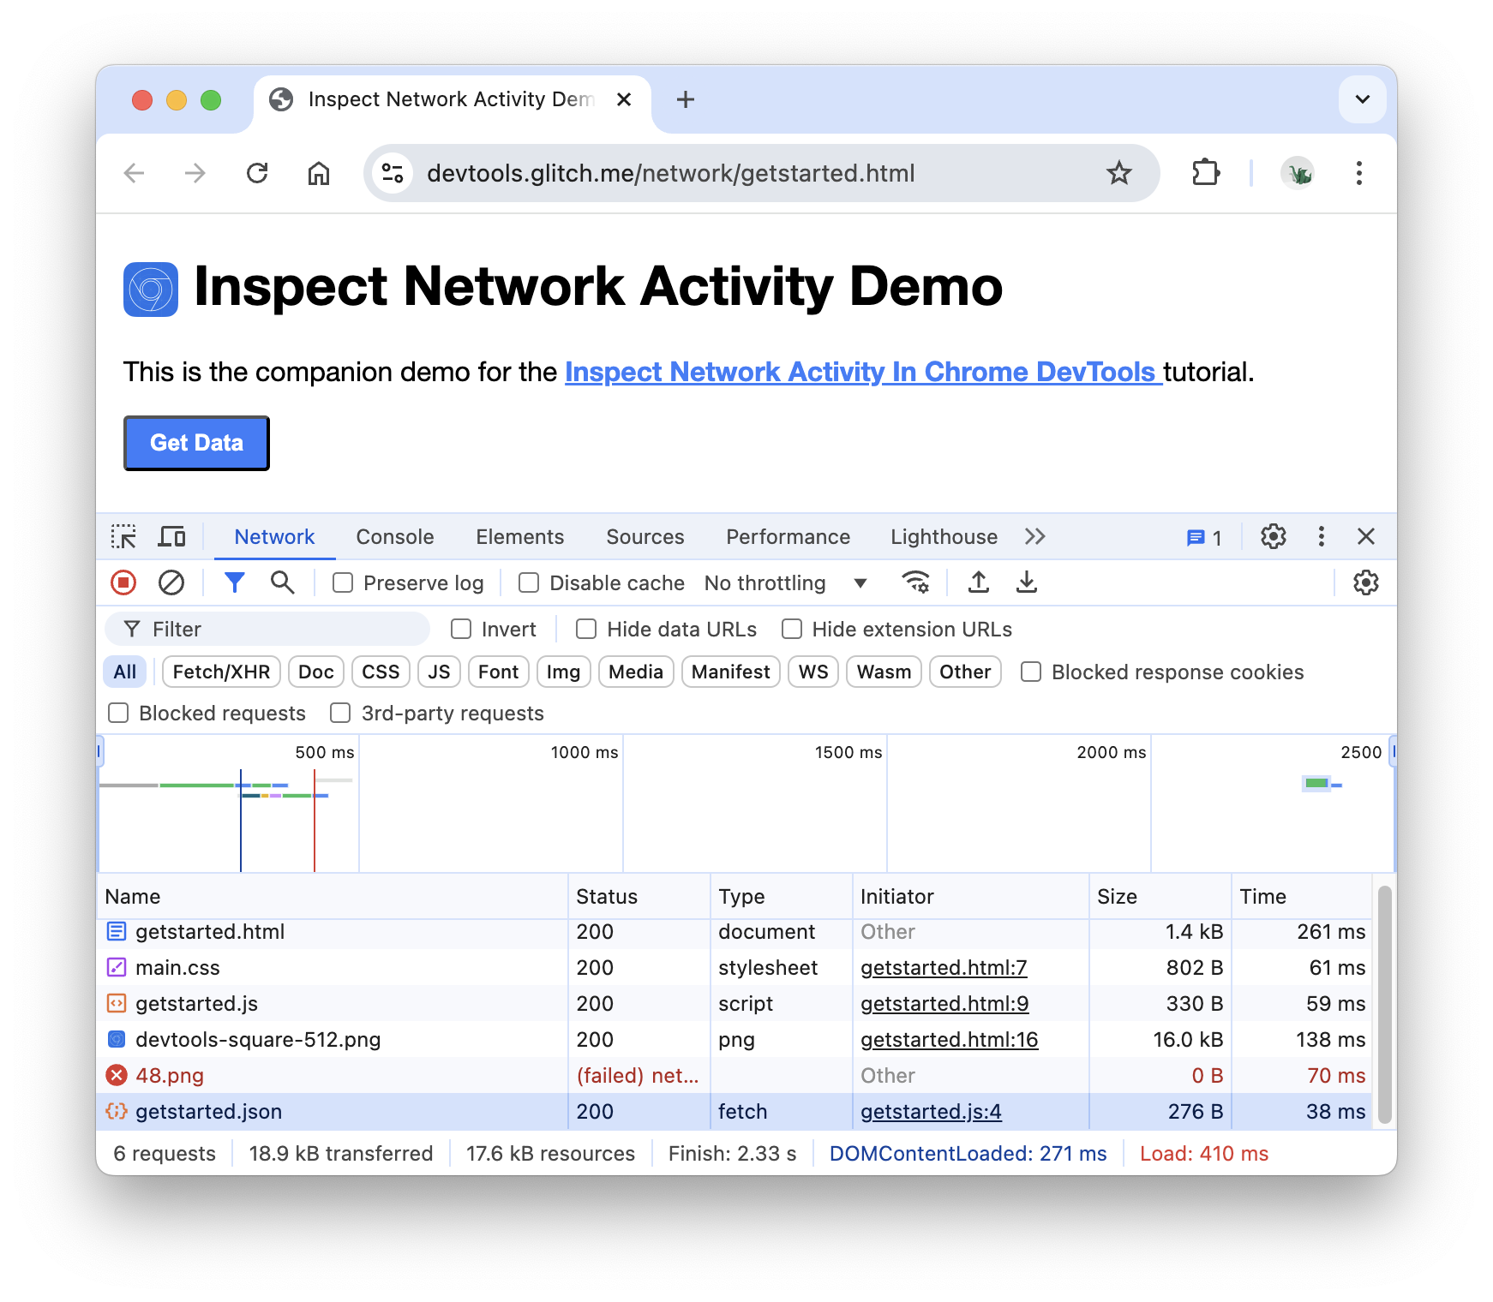
Show more information
The columns of the Network Log are configurable. You can hide columns that you're not using. There
are also many columns that are hidden by default which you may find useful.
 Right-click the header of the Network Log table and select Domain. The domain of each
resource is now shown.

Slide 27
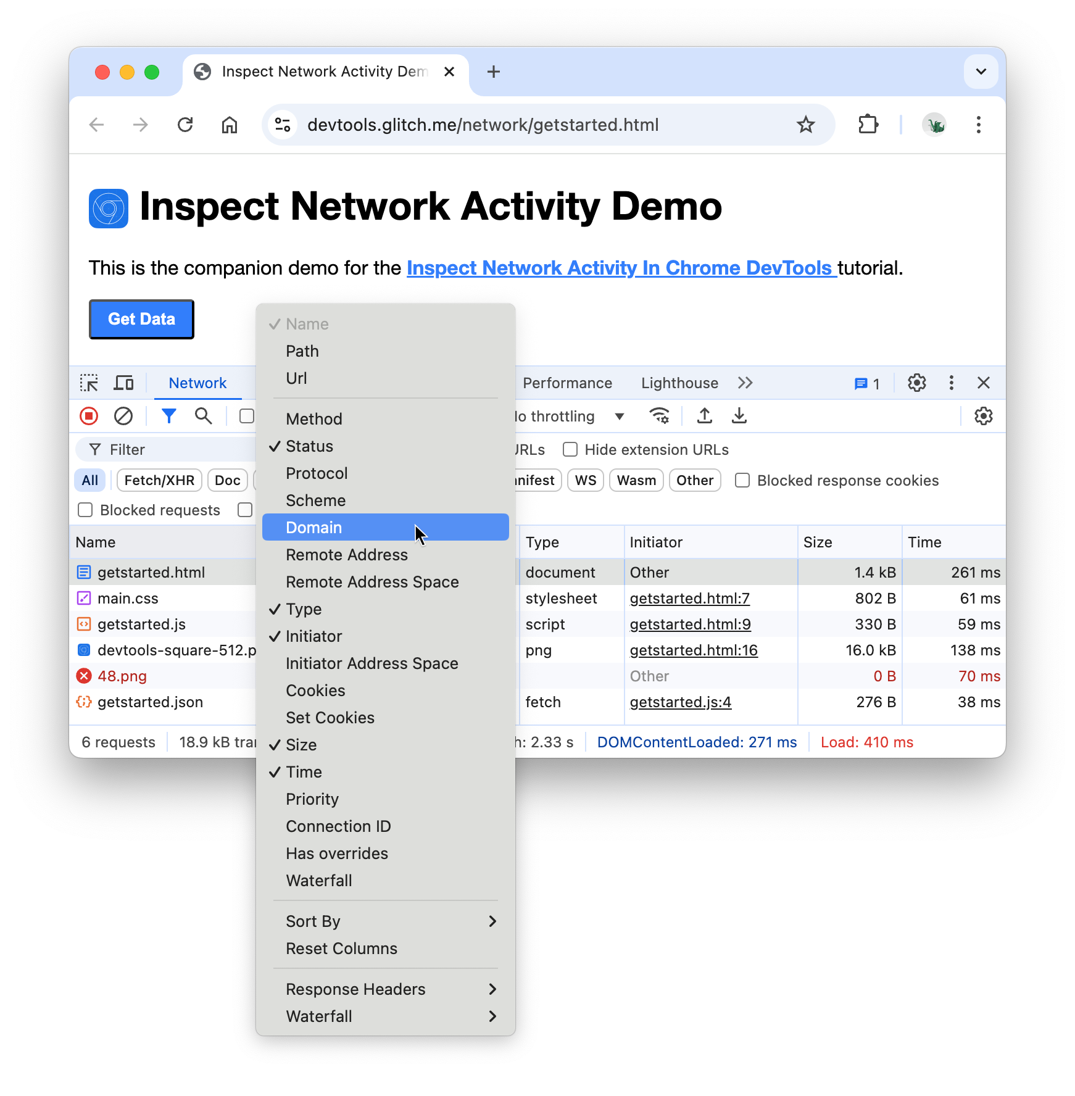
Simulate a slower network connection
The network connection of the computer that you use to build sites is probably faster than the
network connections of the mobile devices of your users. By throttling the page you can get a better
idea of how long a page takes to load on a mobile device.
 Click the Throttling drop-down, which is set to No throttling by default.

Slide 28
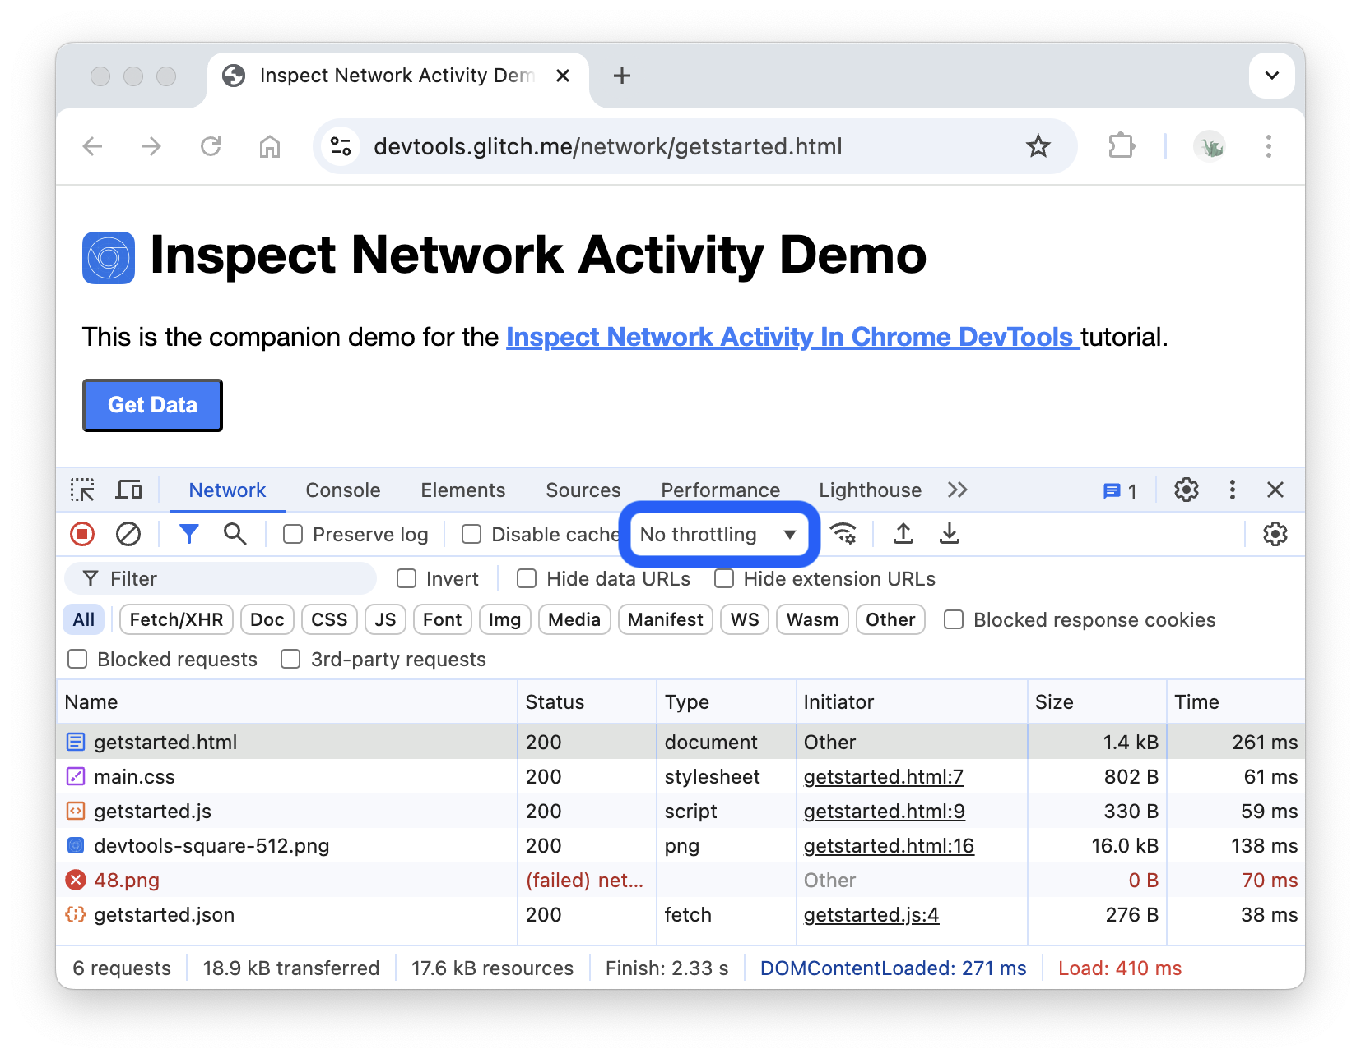
 Select 3G.

Slide 29
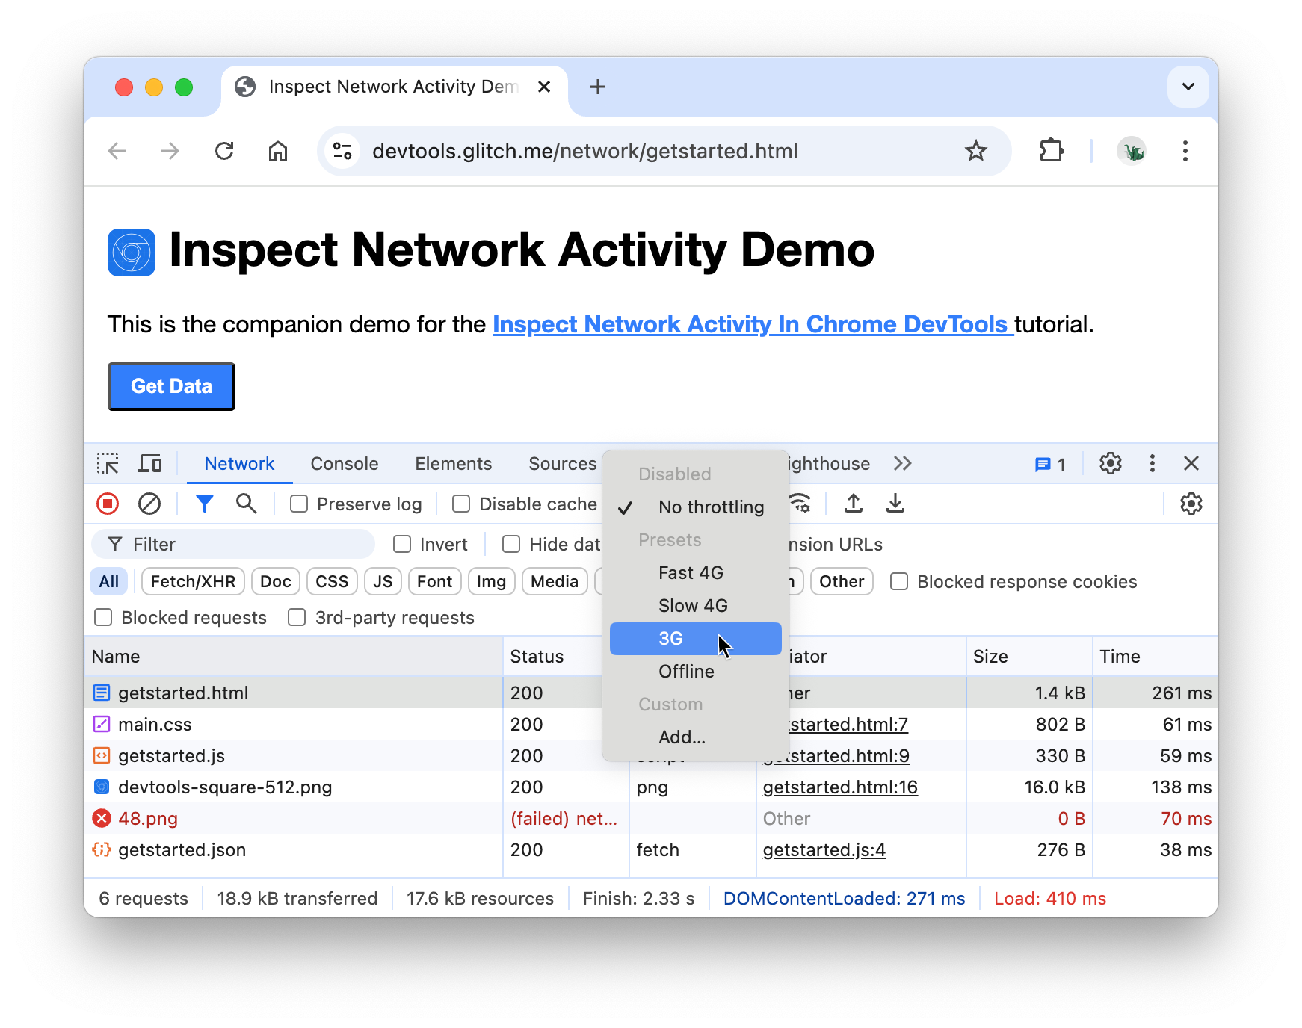
 Long-press Reload refresh and then select Empty Cache And Hard Reload.

Slide 30
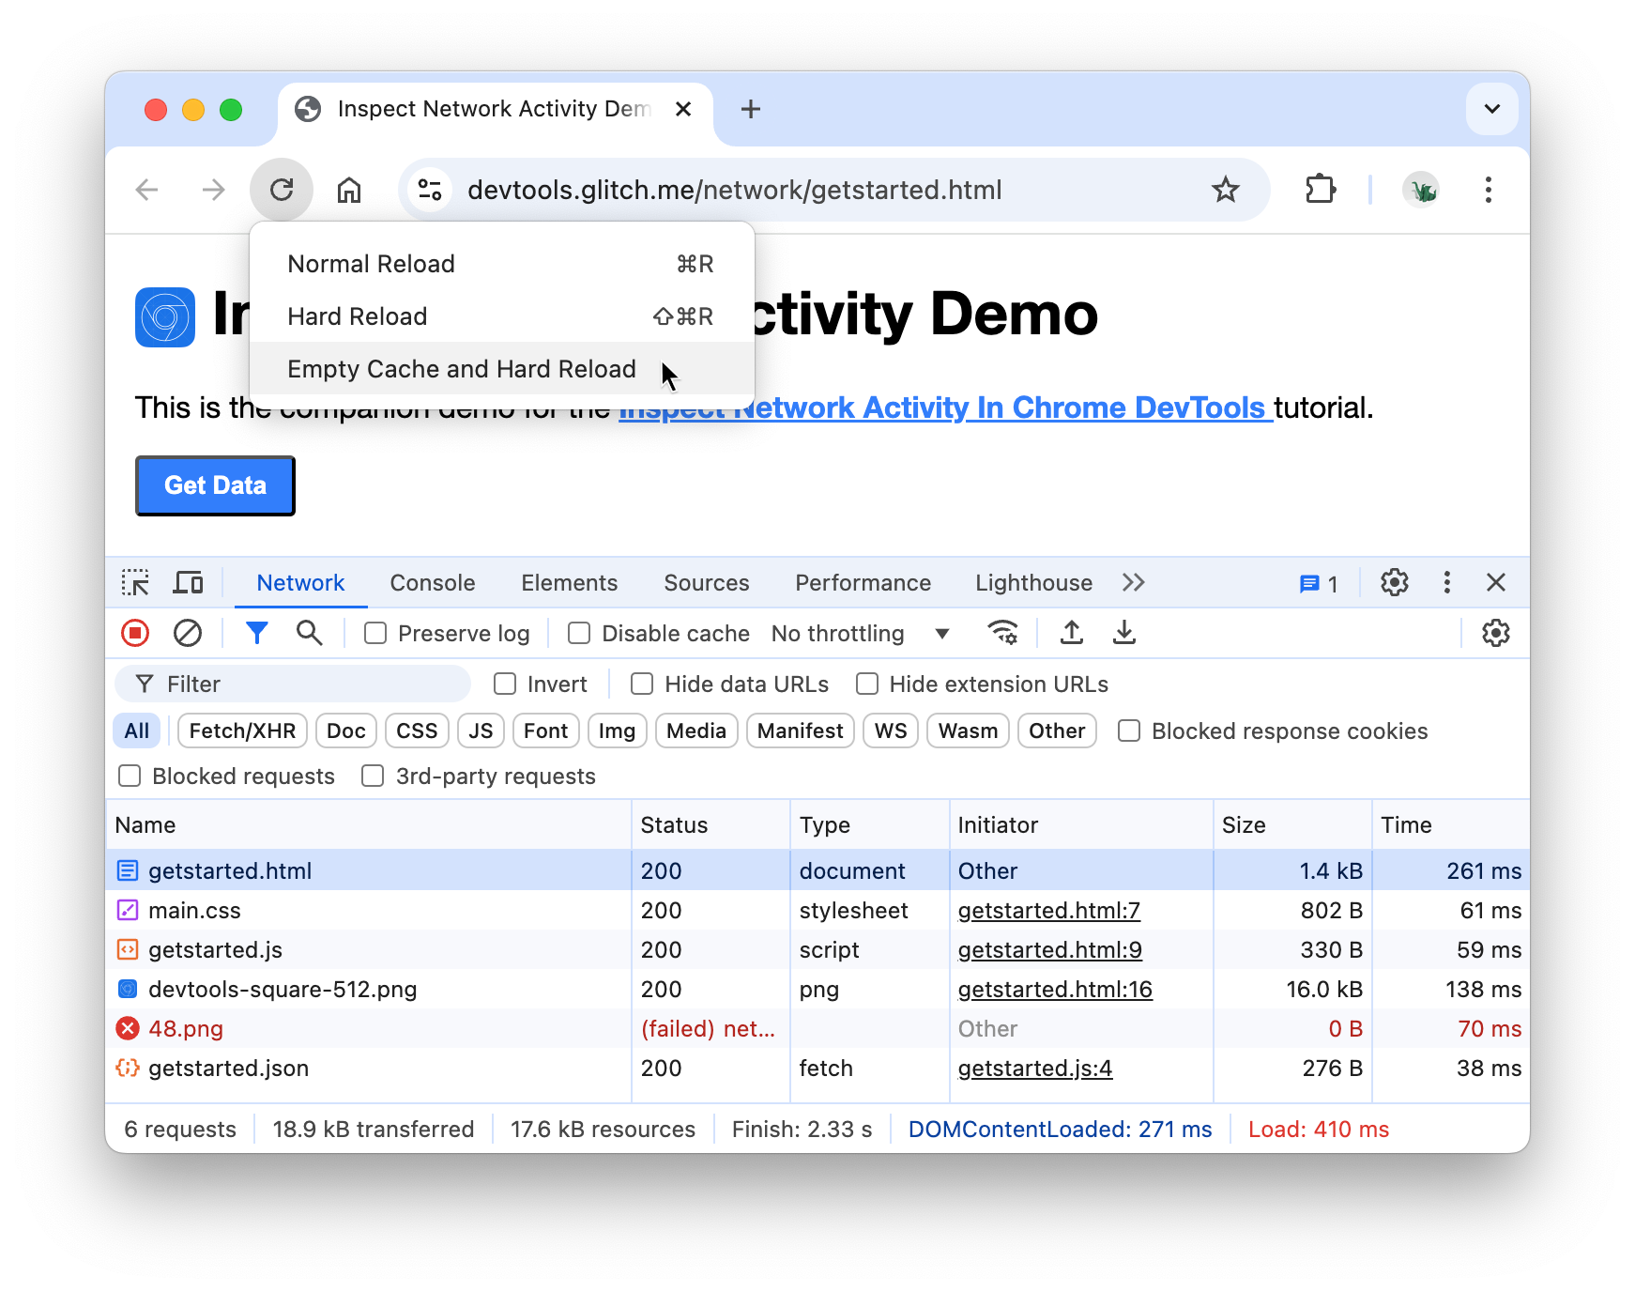
On repeat visits, the browser usually serves some files from its cache, which speeds up the
page load.
Empty Cache And Hard Reload forces the browser to go the network for all resources. This is helpful when you want to see how a first-time visitor
experiences a page load.
Capture screenshots
Click Network Settings settings.
Enable the Screenshots check_box checkbox.
Reload the page again using the Empty Cache And Hard Reload workflow.

Slide 31
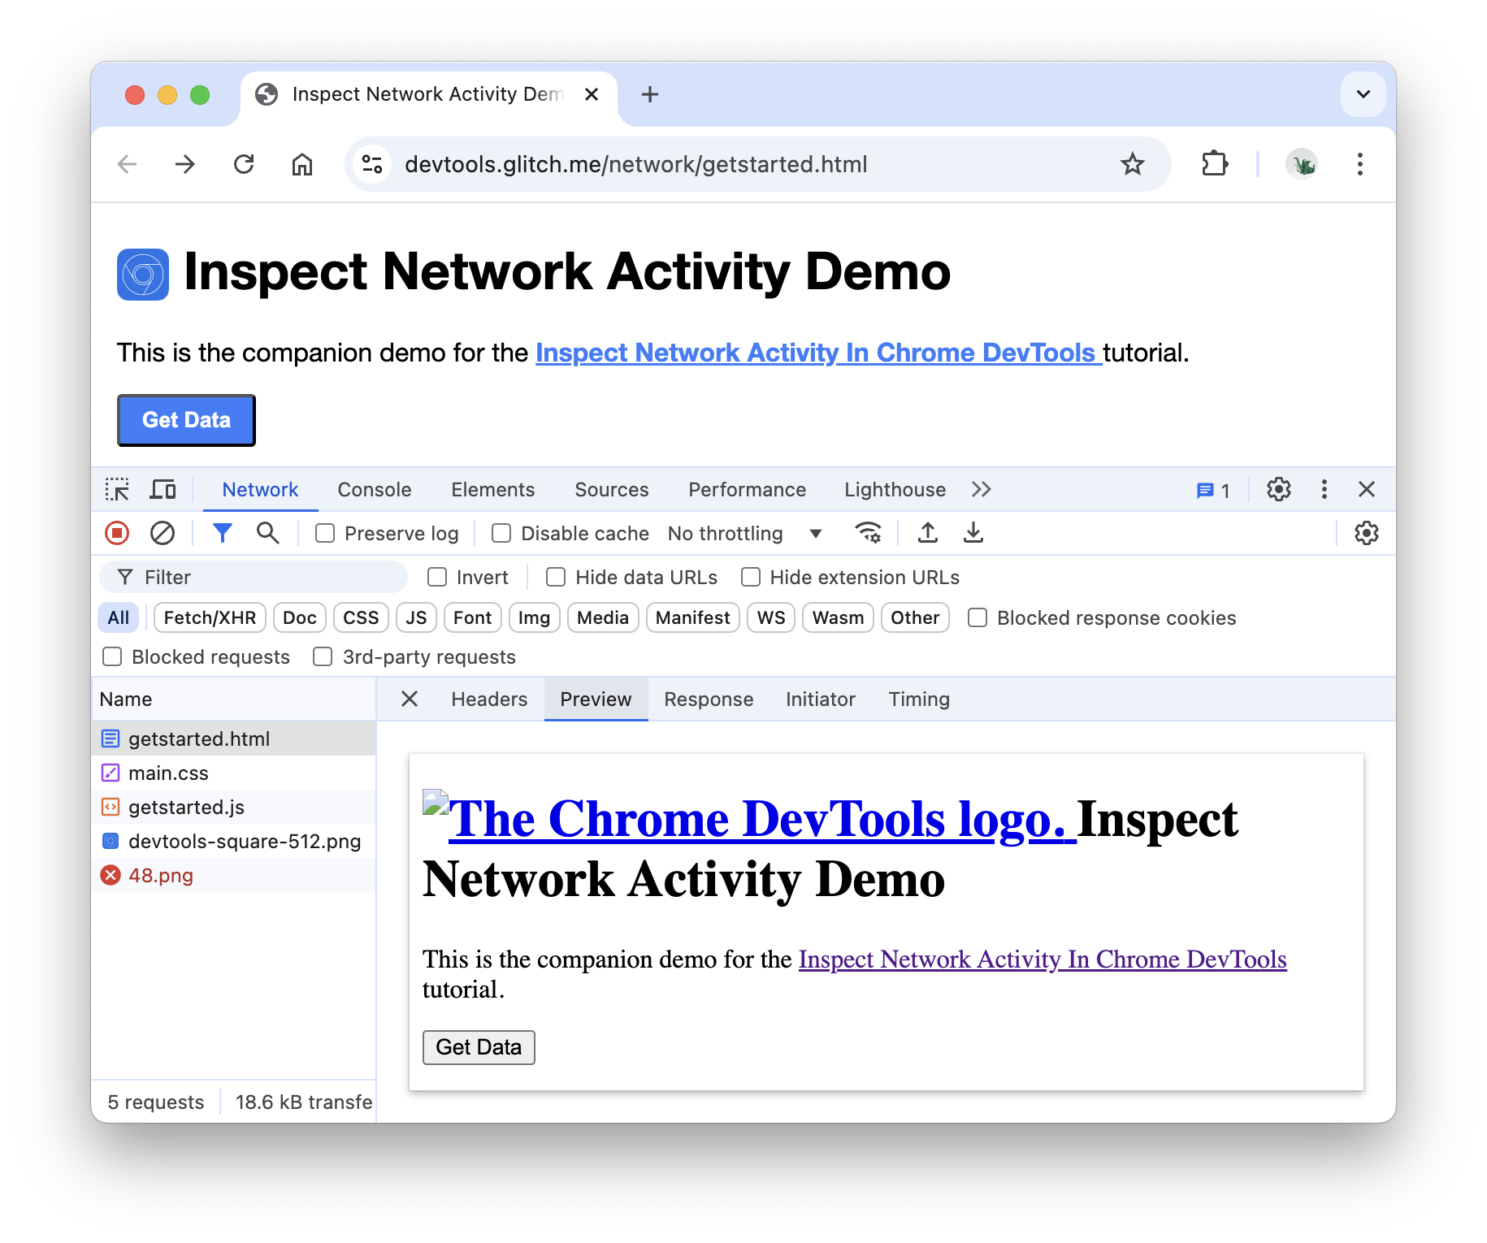
Inspect a resource's details
 Click getstarted.html . The Headers tab is shown. Use this tab to inspect HTTP headers.
 Click the Preview tab to view a basic HTML rendering.
This tab is helpful when an API returns an error code in HTML and it's easier to read the
rendered HTML than the HTML source code, or when inspecting images.
 Click the Response tab to view the HTML source code.
 Click the Initiator tab to view a tree that maps the request initiator chain.
 Click the Timing tab to view a breakdown of the network activity for this resource.

Slide 32
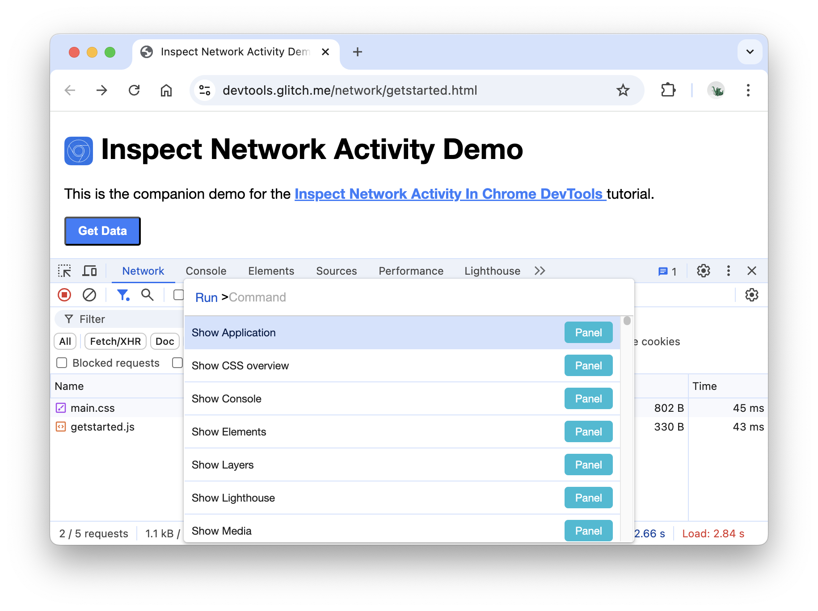
Block requests
 Click Close X to view the Network Log again.
Block requests
How does a page look and behave when some of its resources aren't available? Does it fail
completely, or is it still somewhat functional? Block requests to find out:
 Press Control+Shift+P or Command+Shift+P (Mac) to open the Command Menu.
 Type block , select Show Request Blocking, and press Enter.

Slide 33
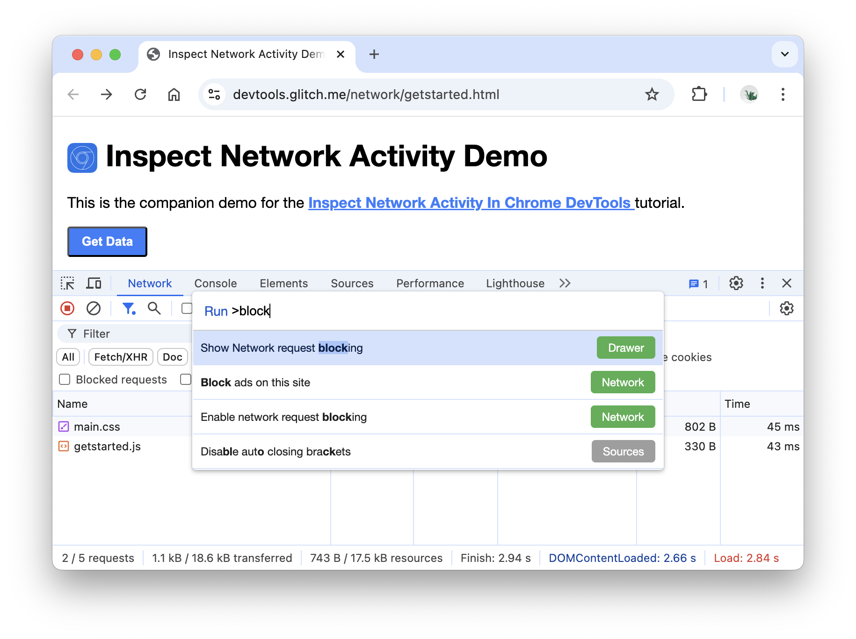
 Click the Add Pattern button.
 Type main.css .

Slide 34
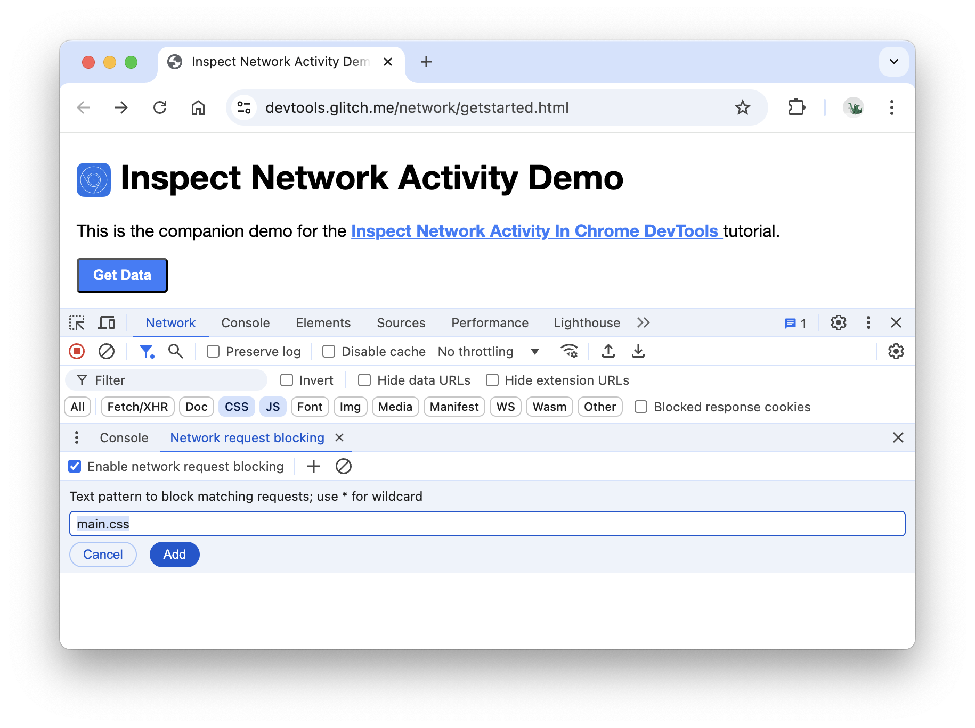
 Click Add.
 Reload the page. As expected, the page's styling is slightly messed up because its main
style sheet has been blocked. Note the
main.css row in the Network Log. The red text means that the resource is blocked.

Slide 35
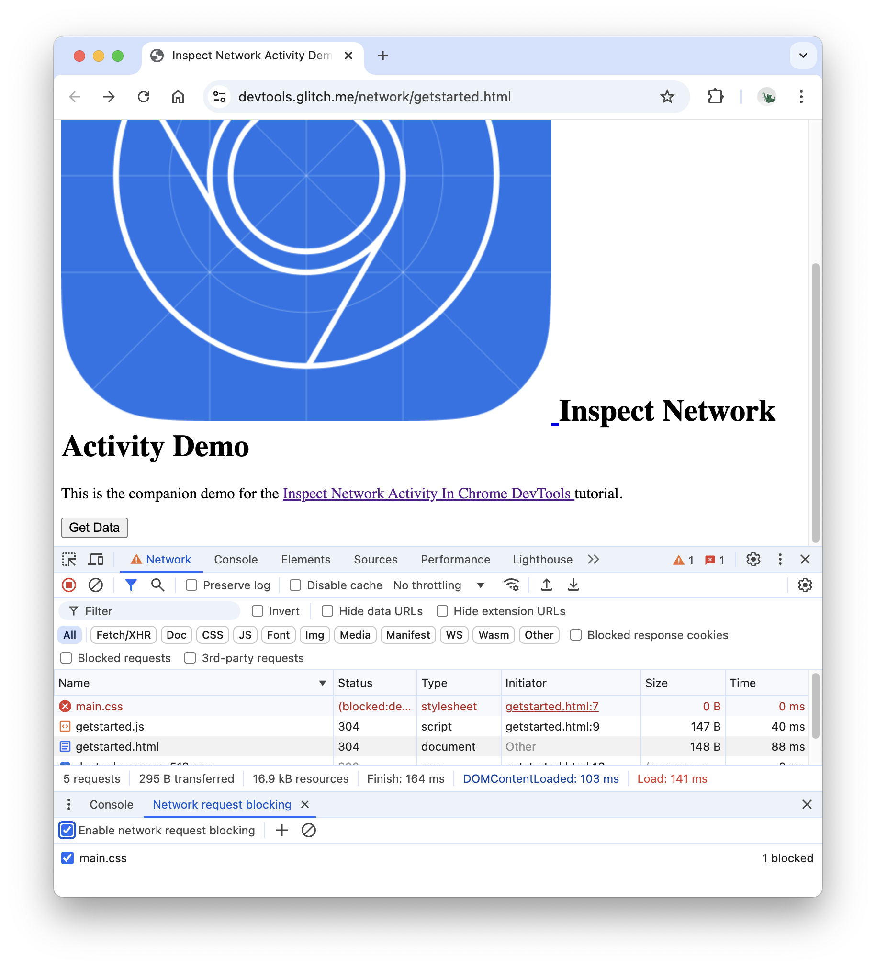
 Clear the Enable request blocking checkbox.
Record network requests
By default, DevTools records all network requests in the Network panel, so long as DevTools is open.
Stop recording network requests

Slide 36


To stop recording requests:
Click Stop recording network log on the Network panel. The icon turns grey to indicate that DevTools is no longer recording requests.
Press Command  E (Mac) or Control  E Windows, Linux) while the Network
panel is in focus.
Clear requests
Click Clear
on the Network panel to clear all requests from the Requests table.
Save requests across page loads
To save requests across page loads, check the Preserve log checkbox on the
Network panel. DevTools saves all requests until you disable Preserve log.
The Network Waterfall
A visual breakdown of each request's activity. Let's talk about the life of a network request.
◻ Queueing
There are higher priority requests.
There are already six TCP connections open for this origin, which is the limit. Applies to HTTP/1.0 and HTTP/1.1 only.
The browser is briefly allocating space in the disk cache
⬜ Stalled
The request is stuck Queueing

Slide 37
🟩 DNS Lookup
Resolving an IP address
🟧 Initial Connection
TCP handshakes or establishing SSL
🟧 Service Worker Startup
Starting up a Service Worker
🟪 Service Worker respondsWith
Service Worker sending data to browser
🟩 Waiting TTFB
Waiting for the first byte from the server
🟦 Content Download
Browser is receiving a response from a server

